Slide 1
Style Filter final project report
Team2
吳建賢、黃柯里、黃少輔、姜維

Slide 2
Outline
Algorithm C-source code
Catapult HLS code
FSIC
Testbench (nwave)

Slide 3
Outline
Algorithm C-source code
Catapult HLS code
FSIC
Testbench (nwave)

Slide 4
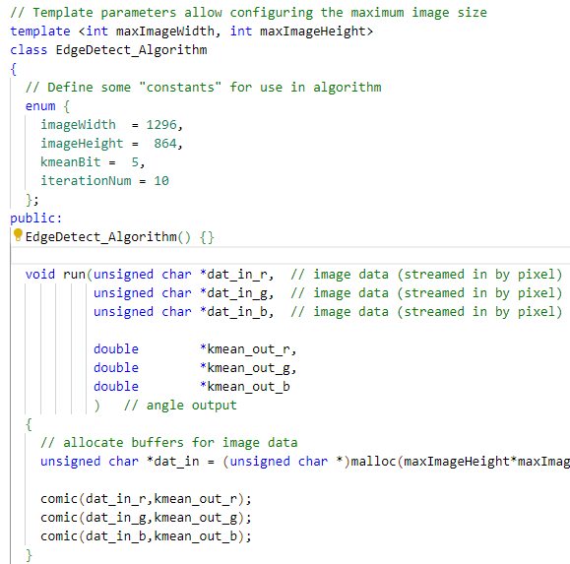
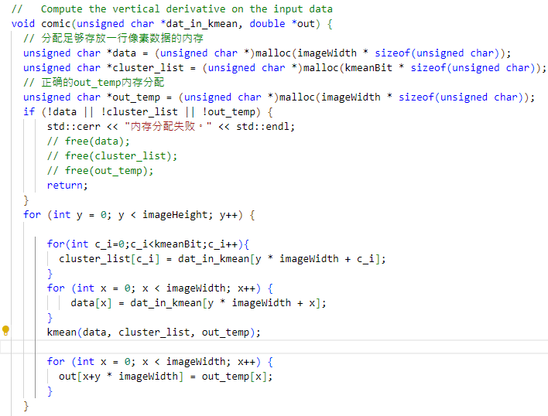
Identify algorithm C-source code
Code review(main.cpp)

Slide 5
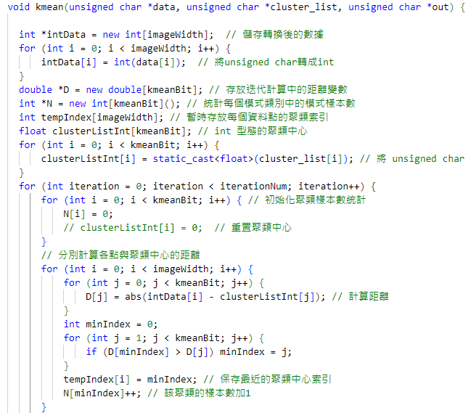
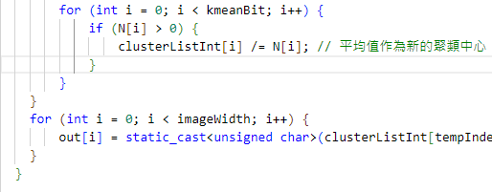
Identify algorithm C-source code
Code review(kmean.h)
Iteration

Slide 6


Identify algorithm C-source code
Outcome picture

Slide 7
Outline
Algorithm C-source code
Catapult HLS code
FSIC
Testbench (nwave)

Slide 8
Identify Catapult HLS code
Block diagram design
testbench
dat
HOR
dx
Mag
magn
mix
dat_in
VerDer
dy
FIFO
dy
dat_rgb
kmean
dat_kmean

Slide 9
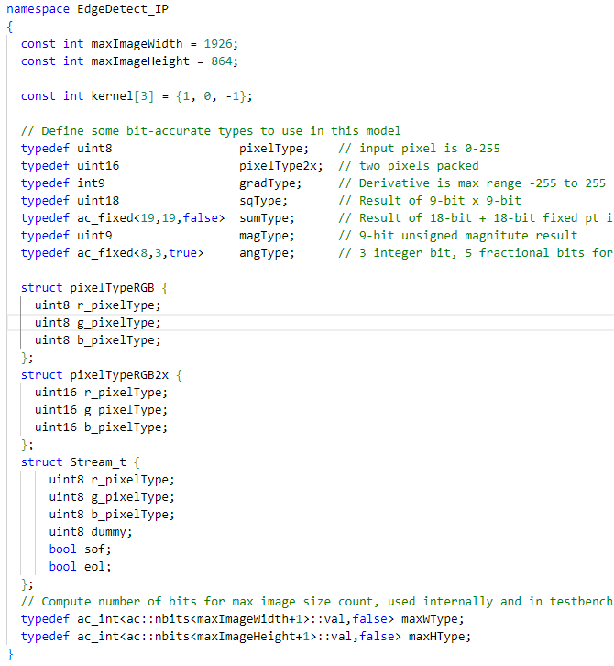
Identify Catapult HLS code
Code review(Edgedect_def.h)

Slide 10
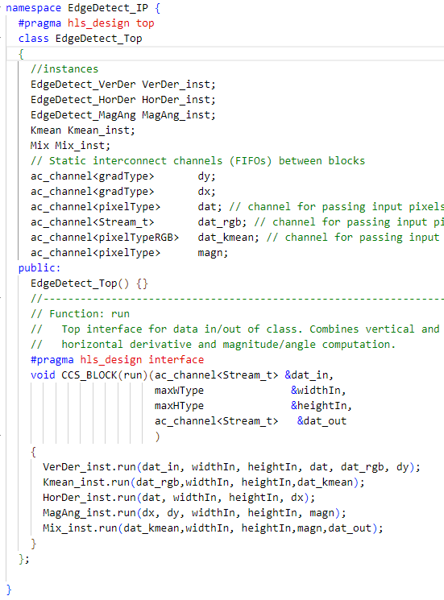
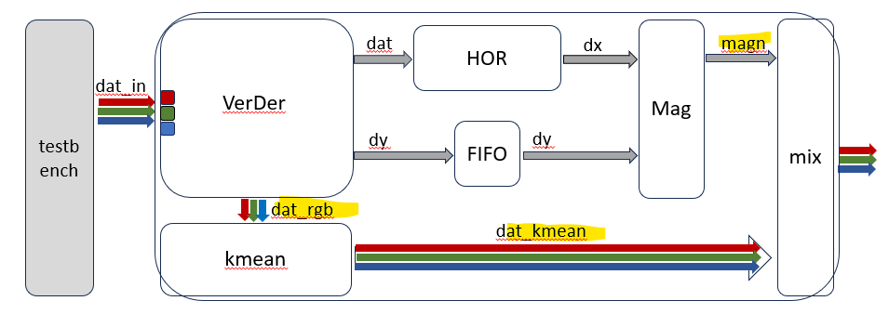
Identify Catapult HLS code
Code review(Edgedect.h)
New interconnect
New module

Slide 11
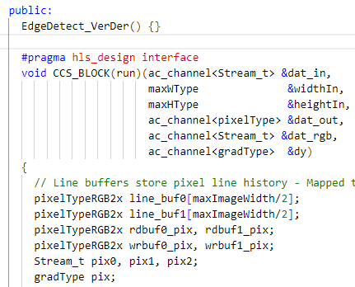
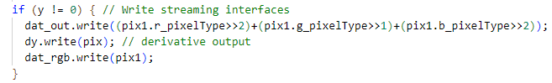
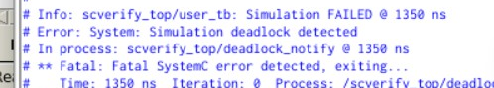
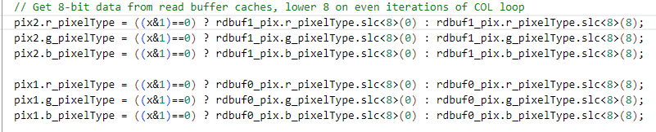
Identify Catapult HLS code
Code review(VerDer.h)
輸出灰階g=(r/4)+(g/2)+(b/4)
輸出3通道rgb
PROBLEM: 死鎖問題
Define 3 channel line_buf

Slide 12
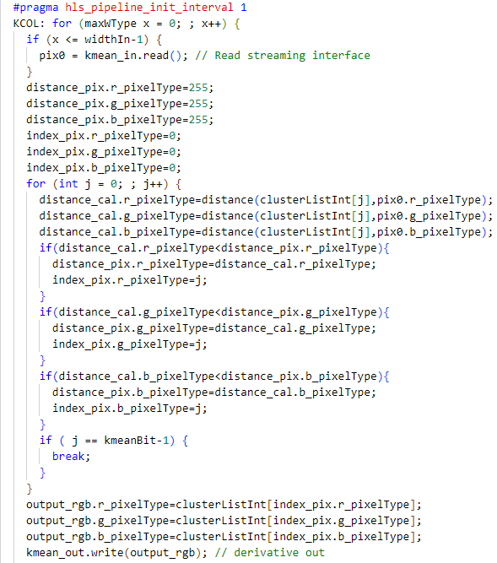
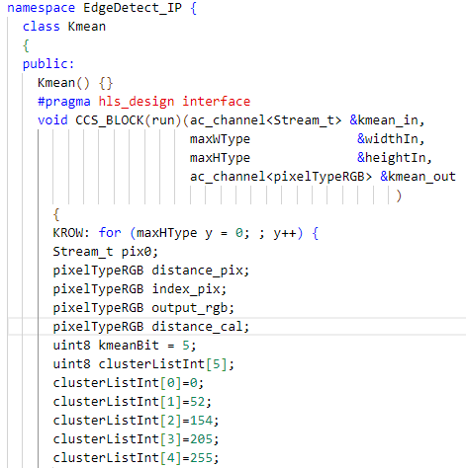
Identify Catapult HLS code
Code review(Kmean.h)
改了算法? 取消迭代直接計算距離

Slide 13
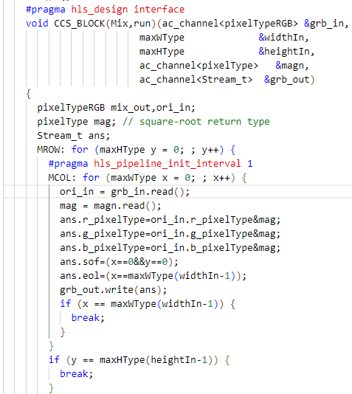
Identify Catapult HLS code
Code review(Mix.h)
Start & End
EdgeDetect + Kmean rgb

Slide 14
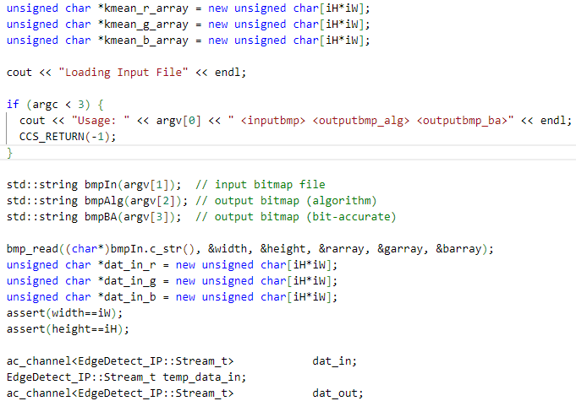
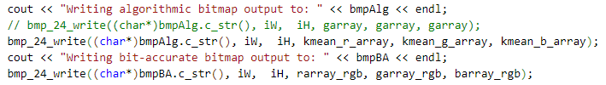
Identify Catapult HLS code
Code review(EdgeDetect_tb.cpp)
Run Top module
Bmp_24_write() kmean_out

Slide 15


Identify Catapult HLS code
Outcome picture

Slide 16
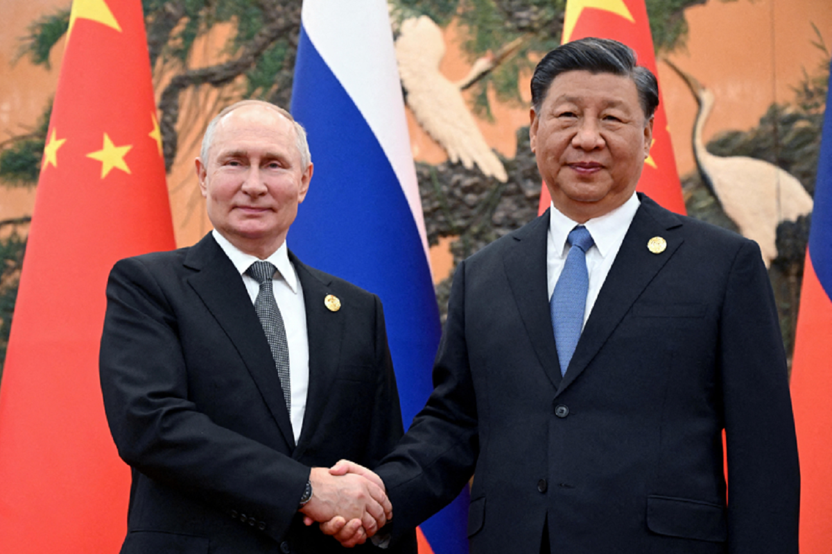
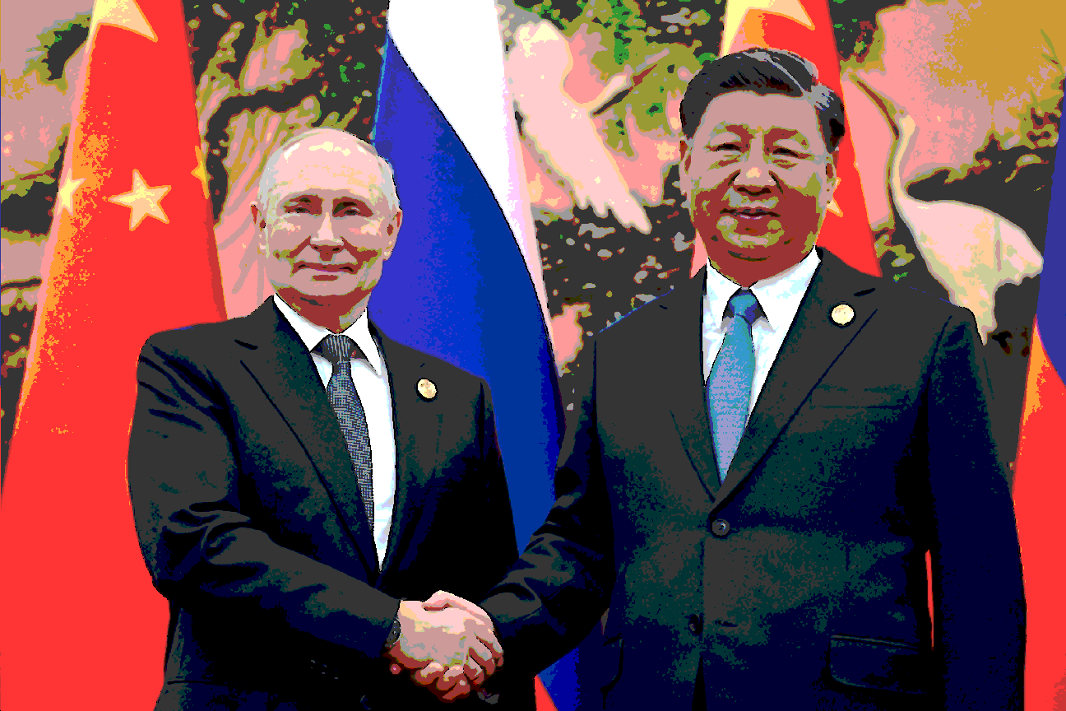
Identify Catapult HLS code
Outcome picture

Slide 17


Identify Catapult HLS code
Outcome picture

Slide 18
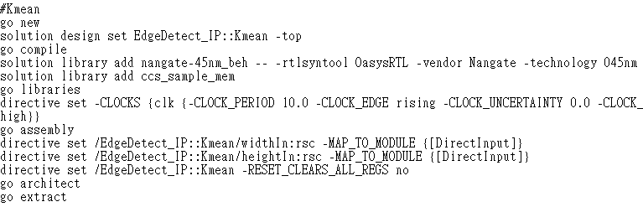
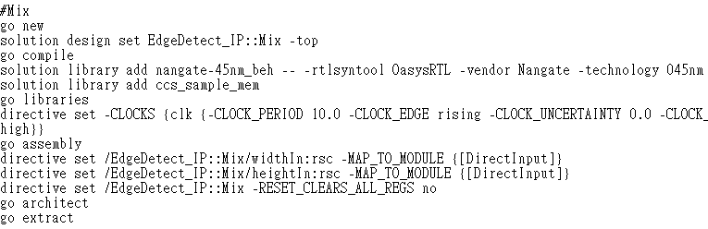
Identify Catapult HLS code
Code review(directives.tcl)

Slide 19
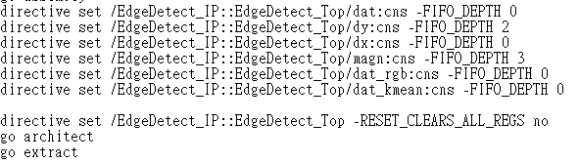
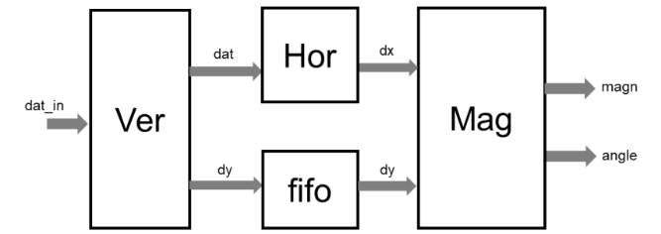
Identify Catapult HLS code
Code review(directives.tcl)
FIFO_DEPTH
2
3
3
2
1
Mix
1
Kmean
6

Slide 20
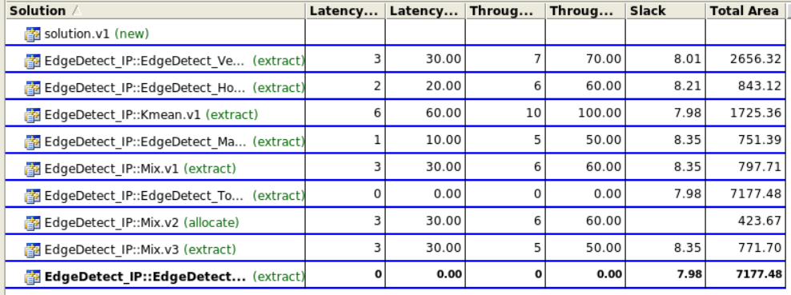
Identify Catapult HLS code
Latency & Area

Slide 21
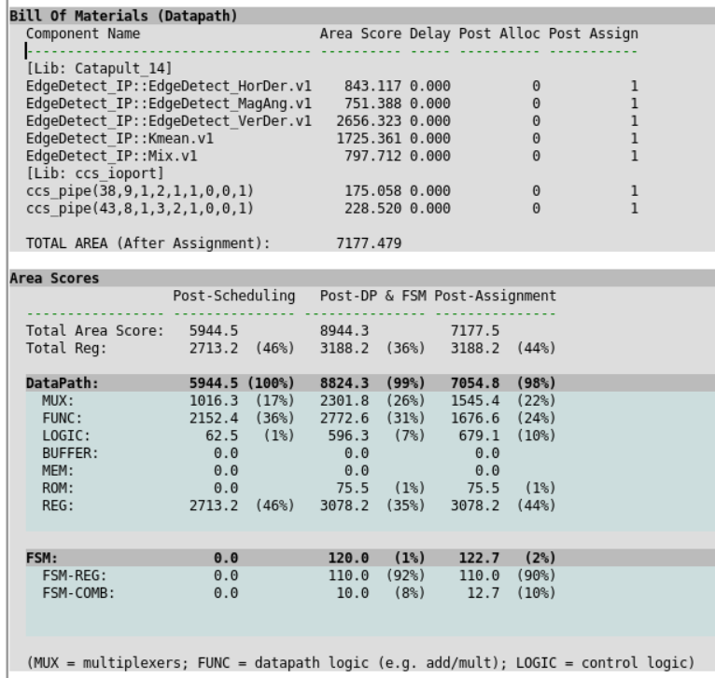
Identify Catapult HLS code
Bill of Materials (BOM), Area Scores, Register-to-Variable,

Slide 22
Outline
Algorithm C-source code
Catapult HLS code
FSIC
Testbench (nwave)

Slide 23
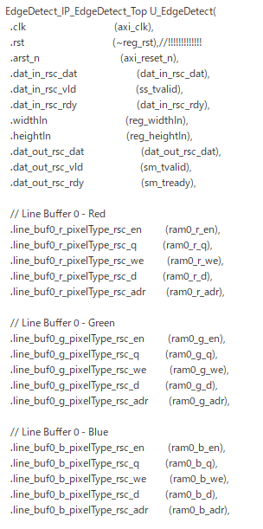
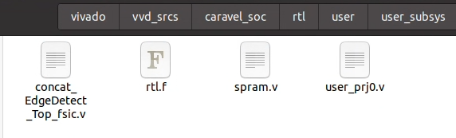
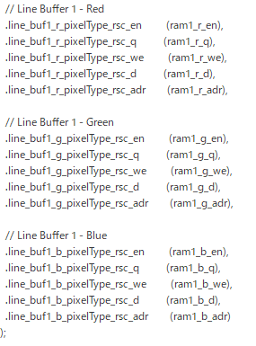
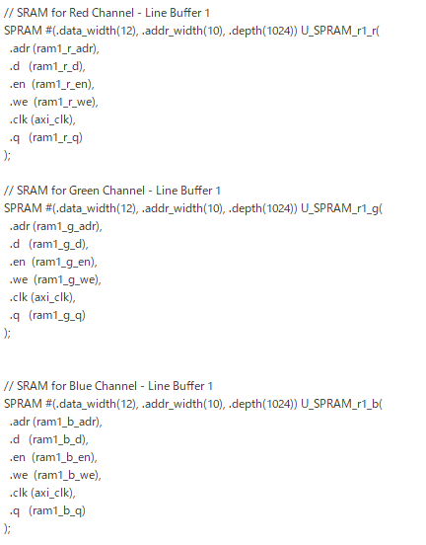
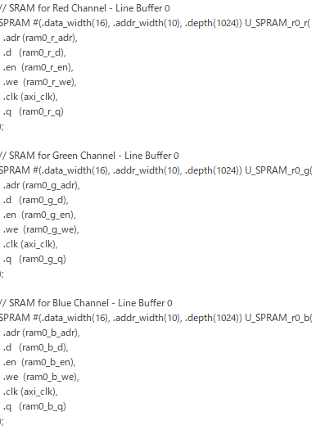
FSIC-FPGA integrate
TOP
In user_prj0

Slide 24
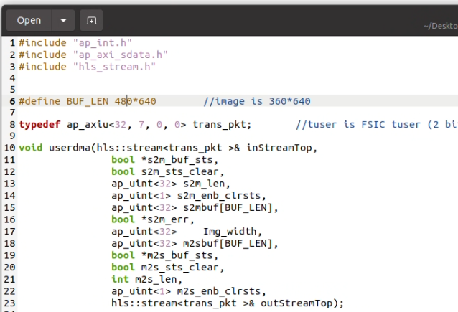
FSIC-FPGA DMA
Eol<1> | SoF <1> | Dummy<7> | Done<1> | R<8> | G<8> | B<8> = 34bits

Slide 25
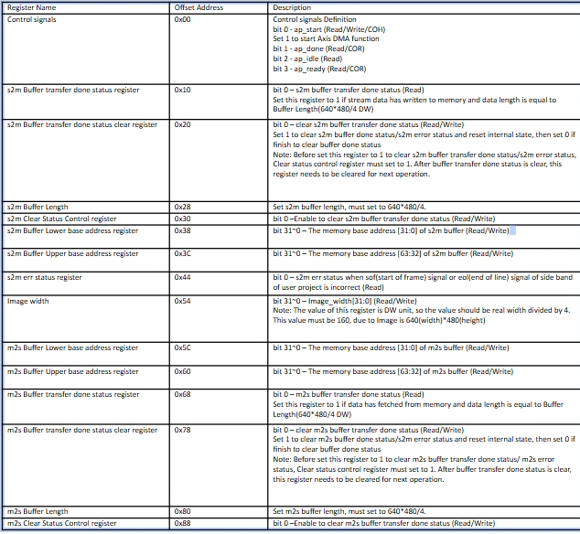
FSIC-FPGA
Testbench -system verilog
DMA setting
Buffer length : 640*480/4 -> 640*480
But we set 40*30 for faster simulation fast
Width : 480/4 -> 480
Config DMA ap start
Config IP ap start

Slide 26
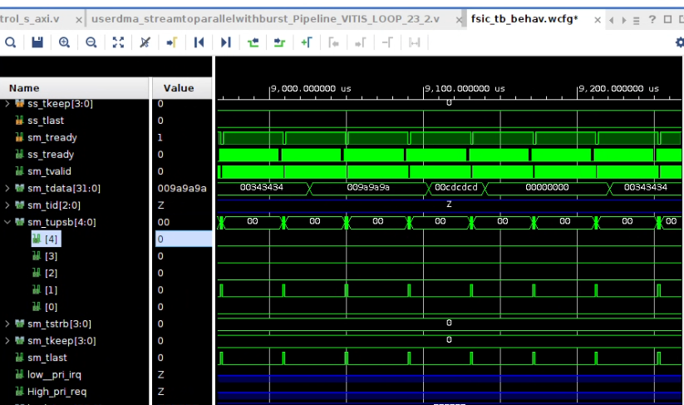
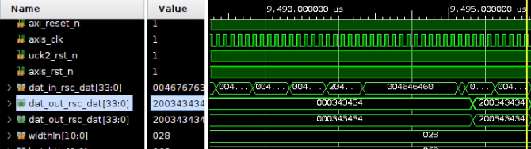
fsic fpga sim
Waveform

Slide 27
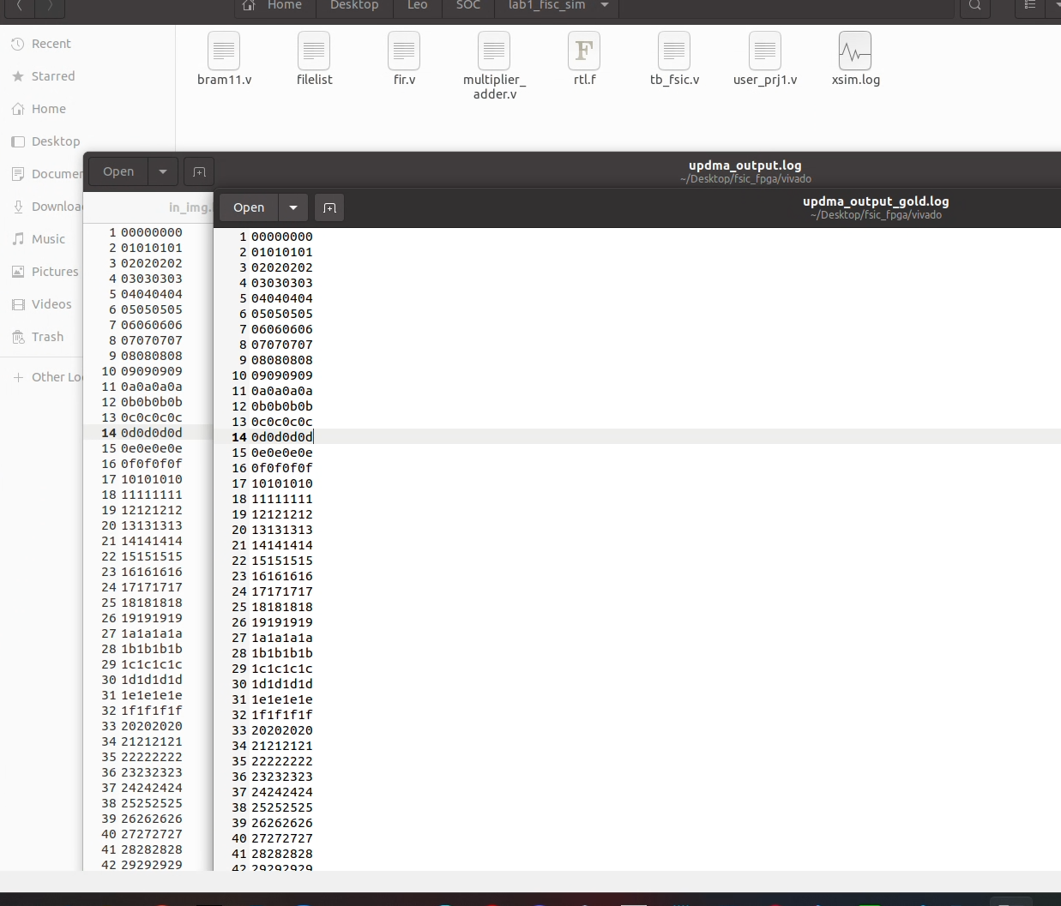
Fsic fpga sim
Dma result

Slide 28
Outline
Algorithm C-source code
Catapult HLS code
FSIC
Testbench (nwave)

Slide 29
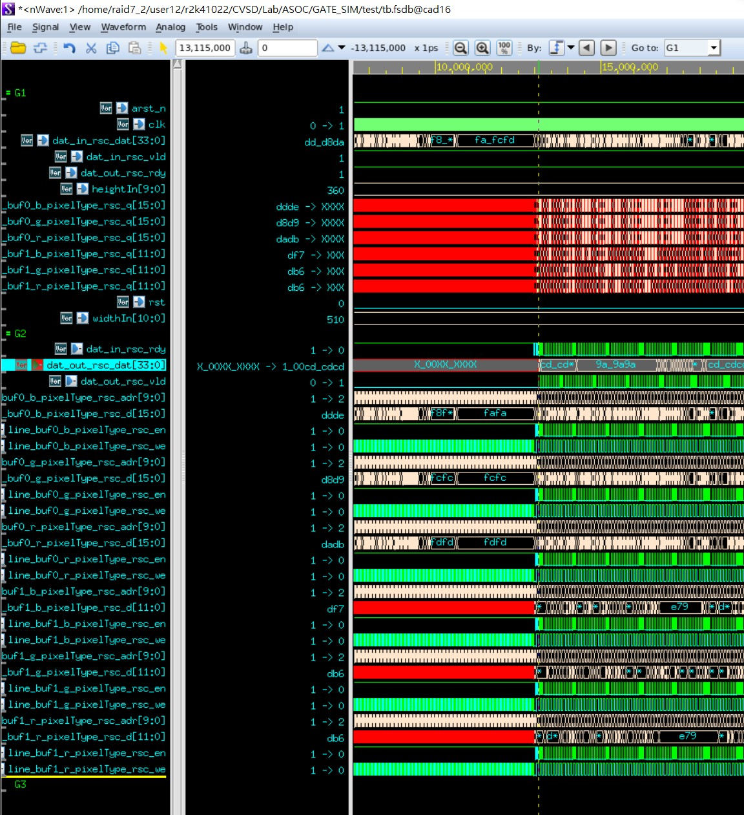
Testbench (nwave)

Slide 30
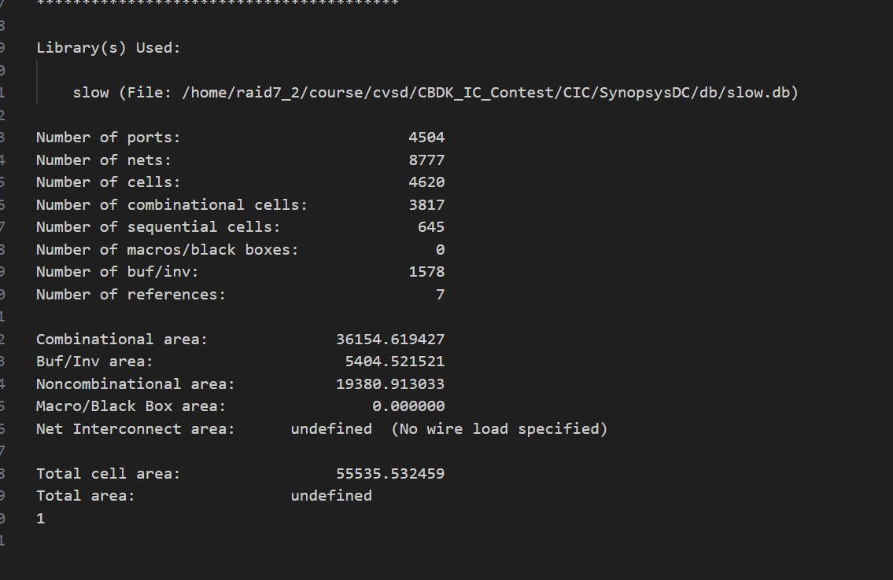
Design Compiler

Slide 31
Thank

